Slide 1
Project 1
Thomas Mackin & Ashley Ridley

Slide 2
Building Blocks
From
Import
.title
.geometry
.resizable
Background
Foreground
.grid
Function (def)
.mainloop

Slide 3
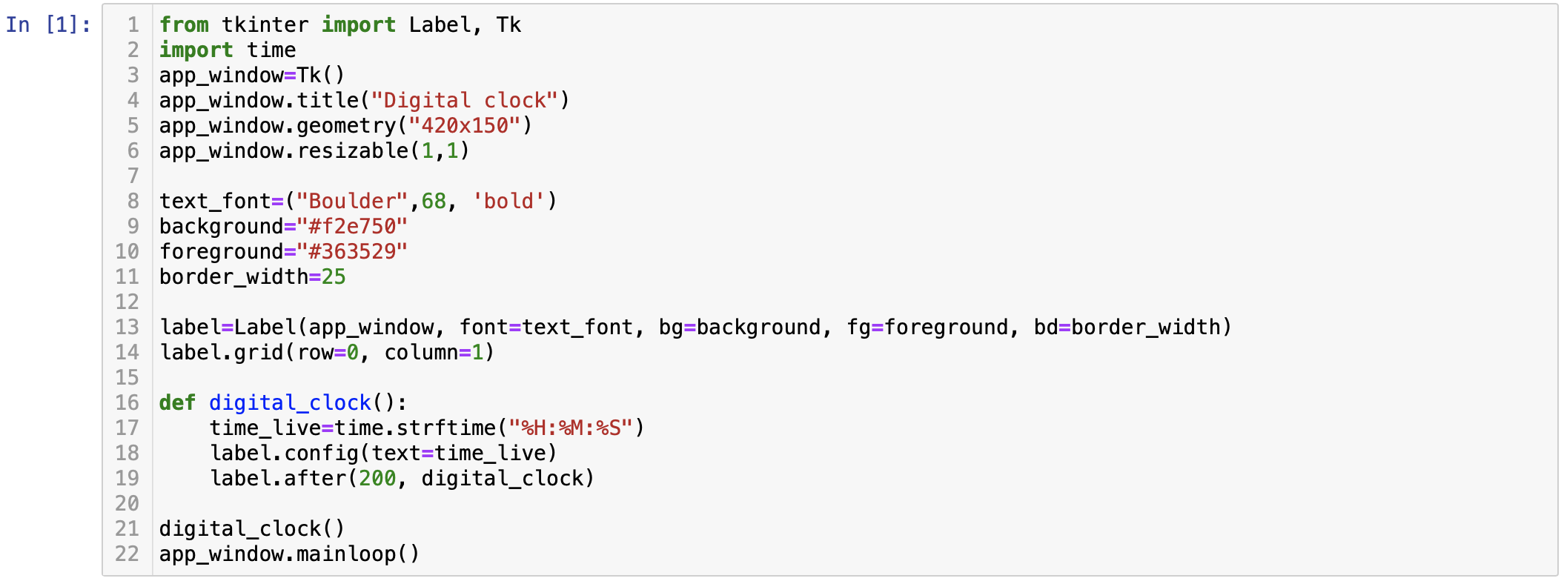
Code

Slide 4
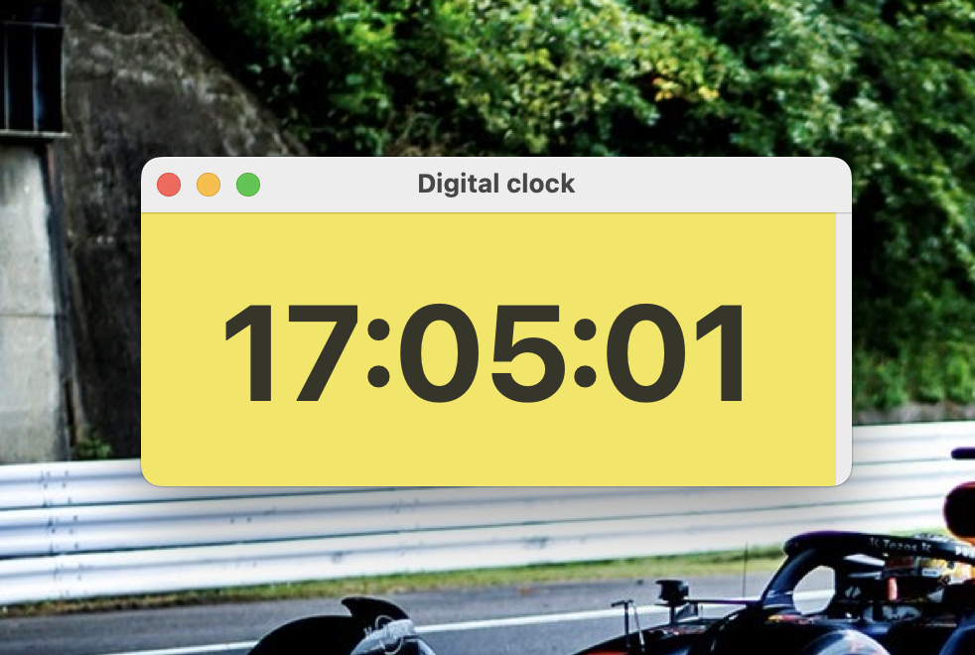
Result

